Slide 1
Intrusion Detection System
Sanket Tilotkar-1211042
Jay Vador1211043
Kamal Vora-1211046
Karan Motani-1211050
Naitik Shah-1211055

Slide 2
Problem definition
The project is about creating an intrusion detection system which would be able to monitor network or system activities for malicious activities or policy violations and produces reports to a management station.
Different types of IDS approach the goal of detecting traffic in different ways. There are network based and host based intrusion detection systems.

Slide 3
Scope
The intrusion detection system would be capable of detecting the following types of attacks:
Any unreliable transmission
TCP attack(Signature attack).
Syn-Flooding attack(Denial of service attack).
ICMP attack(Anomaly Detection).
UDP attack.

Slide 4
What is IDS?
An intrusion detection system (IDS) is a device or software application that monitors network or system activities for malicious activities or policy violations and produces reports to a management station. IDS come in a variety of “flavors” and approach the goal of detecting suspicious traffic in different ways.
There are network based (NIDS) and host based (HIDS) intrusion detection systems.
Network Intrusion Detection Systems (NIDS) are placed at a strategic point or points within the network to monitor traffic to and from all devices on the network.
Host Intrusion Detection Systems (HIDS) run on individual hosts or devices on the network.

Slide 5
Passive and reactive systems
In a passive system, the intrusion detection system (IDS) sensor detects a potential security breach, logs the information and signals an alert on the console or owner.
In a reactive system, also known as an intrusion prevention system (IPS), the IPS auto-responds to the suspicious activity by resetting the connection or by reprogramming the firewall to block network traffic from the suspected malicious source.
In this project we restrain ourselves to IDS.

Slide 6
Detection techniques in IDS
Statistical anomaly-based IDS
monitor network traffic
compare it against an established baseline
The baseline will identify what is “normal” for that network- what sort of bandwidth is generally used, what protocols are used, what ports and devices generally connect to each other- and alert the administrator or user when traffic is detected which is anomalous, or significantly different, than the baseline.
False Positive alarm for a legitimate use of bandwidth if the baselines are not intelligently configured

Slide 7
Signature-based IDS
monitor packets on the network
compare them against a database of signature or attributes from known malicious threats
issue is that there will be a lag between a new threat being discovered in the wild and the signature for detecting that threat being applied to the IDS.
During that lag time the IDS would be unable to detect the new threat.

Slide 8
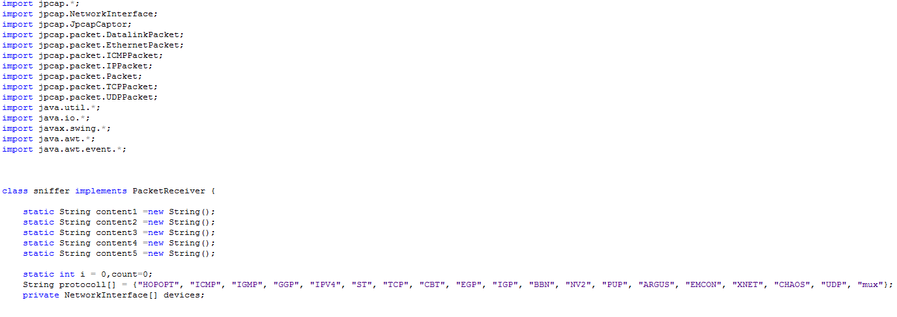
Program and implementation
Header Files and Protocols:

Slide 9
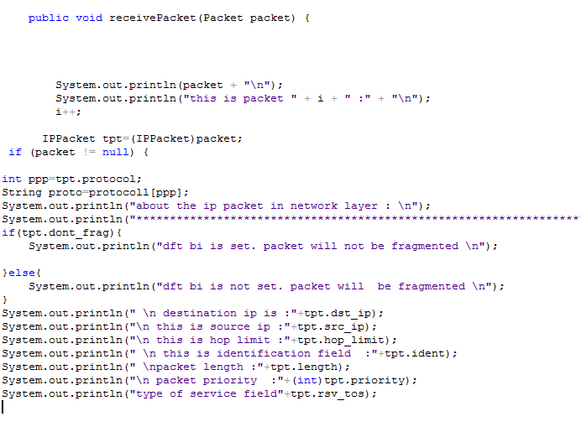
The packets will be captured with the help of JPcapCaptor.
Information of the packet being analyzed is displayed:

Slide 10
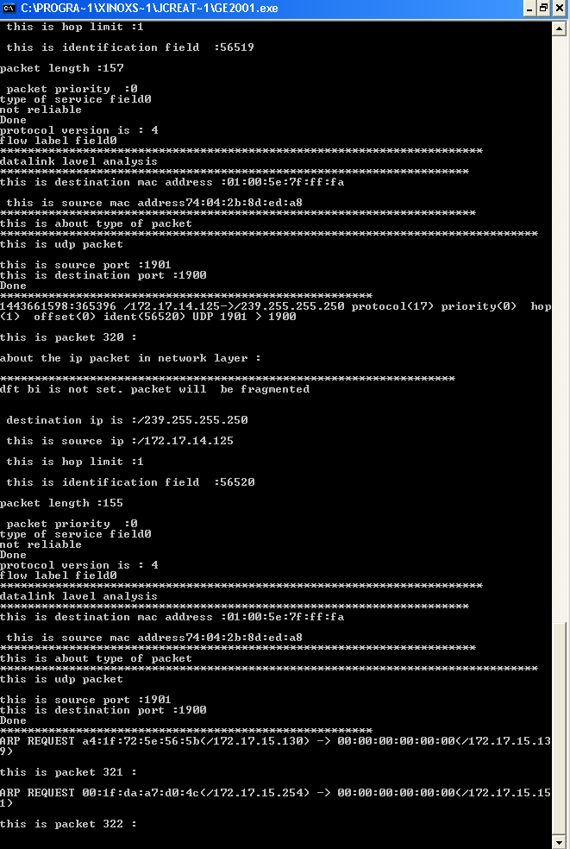

Slide 11
Attack Types
Reliable Transmission/Unreliable Transmission:
TCP uses a sequence number to identify each byte of data. The sequence number identifies the order of the bytes sent from each computer so that the data can be reconstructed in order, regardless of any fragmentation, disordering, or packet loss that may occur during transmission.
tpt.r_flag is checked for reliability.

Slide 12
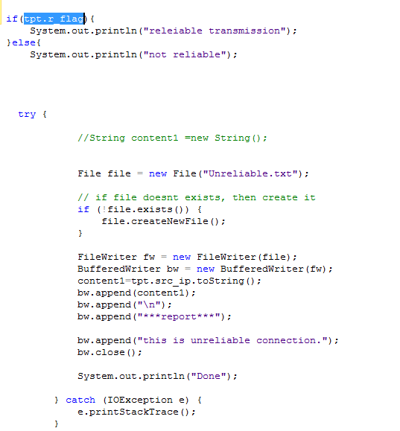

Slide 13
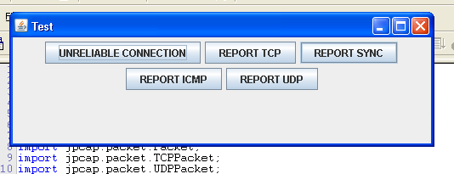
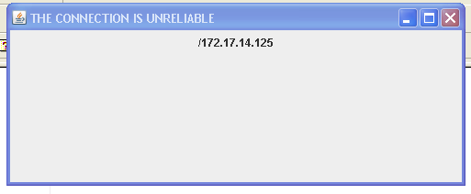

Slide 14
TCP attack
A TCP sequence prediction attack is an attempt to predict the sequence number used to identify the packets in a TCP connection, which can be used to counterfeit packets. The attacker hopes to correctly guess the sequence number to be used by the sending host.
Finding TCP
TCP acknowledgement and TCP reset

Slide 15
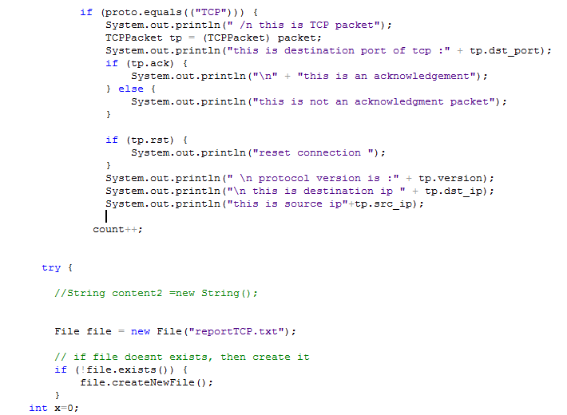

Slide 16
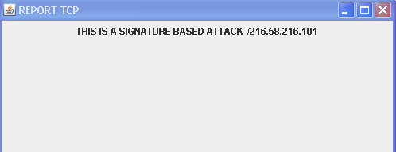

Slide 17

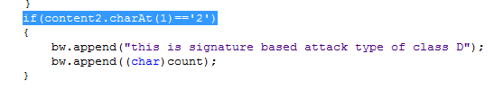
Signature based TCP:
Based on the IP address the attack is performed by which classes can be found out.
In the program:
Class D
Class E

Slide 18
Syn Flooding attack
A SYN flood is a form of denial-of-service attack in which an attacker sends a succession of SYN requests to a target's system in an attempt to consume enough server resources to make the system unresponsive to legitimate traffic.
A SYN flood attack works by not responding to the server with the expected ACK code.
The malicious client can either simply not send the expected ACK, or by spoofing the source IP address in the SYN, causing the server to send the SYN-ACK to a falsified IP address - which will not send an ACK because it "knows" that it never sent a SYN.

Slide 19
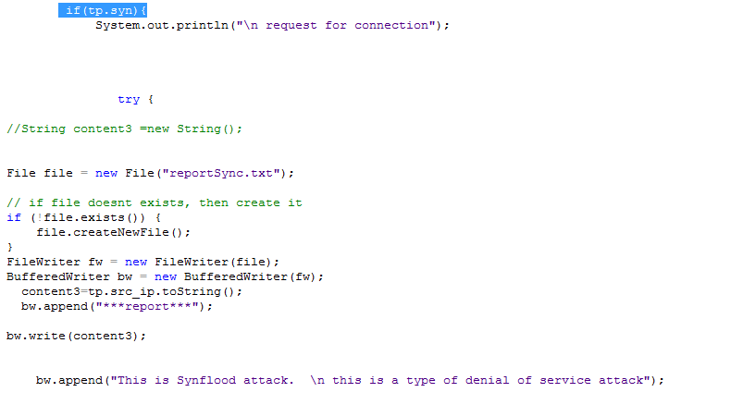

Slide 20
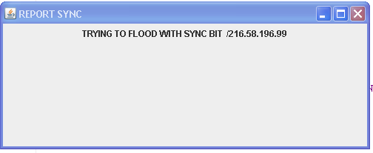

Slide 21
ICMP attack
ICMP stands for Internet Control Message Protocol and is the most used protocol in networking technology. A connectionless protocol, ICMP does not use any port number and works in the network layer.
diagnostic purposes, error reporting or querying any server, and right now attackers are using ICMP to send payloads.
a distributed denial-of-service attack in which large numbers of ICMP packets with the intended victim's spoofed source IP are broadcast to a computer network using an IP Broadcast address.

Slide 22
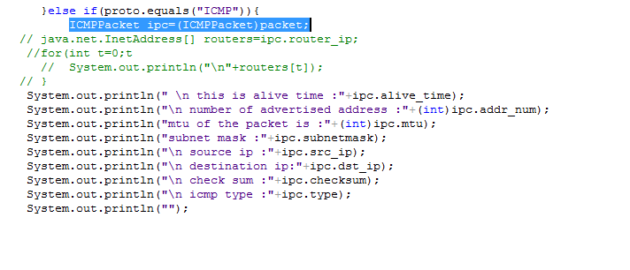
The ICMP packet shows all the following:

Slide 23
ICMP attacks can be of various types:
ICMP Tunnelling: ICMP tunnels are one form of covert channel that is created wherein the information flow is not controlled by any security mechanism.
Smurf Attack: ICMP echo reply is sent whenever an echo request is sent. In a smurf attack, an attacker will spoof the source address of the ICMP packet and send a broadcast to all computers on that network.
Information Gathering: Under the information gathering attack, one can use different methods within the ICMP to find out live host
Trace Route

Slide 24
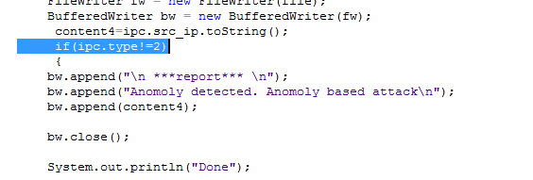
This type of attack can be denoted using:

Slide 25
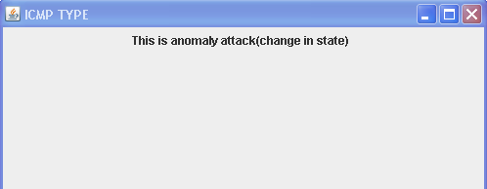

Slide 26
UDP attack:
A UDP flood attack is a denial-of-service (DoS) attack using the User Datagram Protocol (UDP), a sessionless/connectionless computer networking protocol.
UDP flood attack can be initiated by sending a large number of UDP packets to randomports on a remote host.
the distant host will:
Check for the application listening at that port;
See that no application listens at that port;
Reply with an ICMP Destination Unreachable packet.

Slide 27
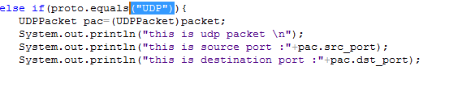
The packet type is verified as UDP and source as well as destination address are printed.

Slide 28
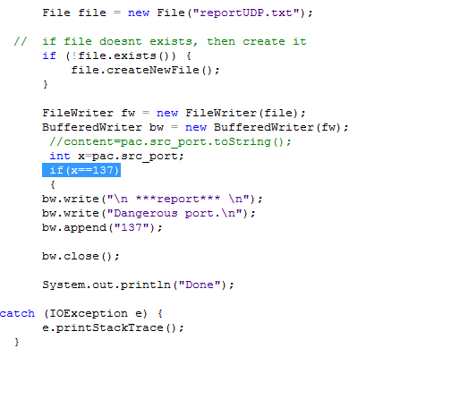
UDP attacks on a private port.

Slide 29
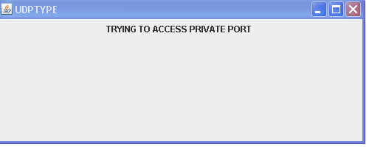

Slide 30
Adding a GUI
Any software requires a user friendly GUI.
Usage of Jframe for GUI addition.
Swing is a GUI widget toolkit for Java.
provide a more sophisticated set of GUI components.
Various buttons are created in the GUI.
Each denotes a type of attack.
Specific actions are specified based on the attacks.

Slide 31
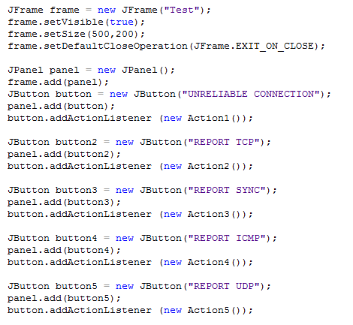

Slide 32
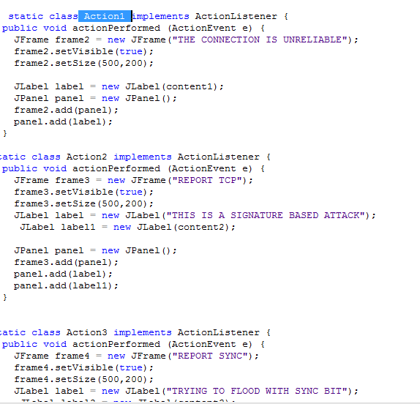

Slide 33
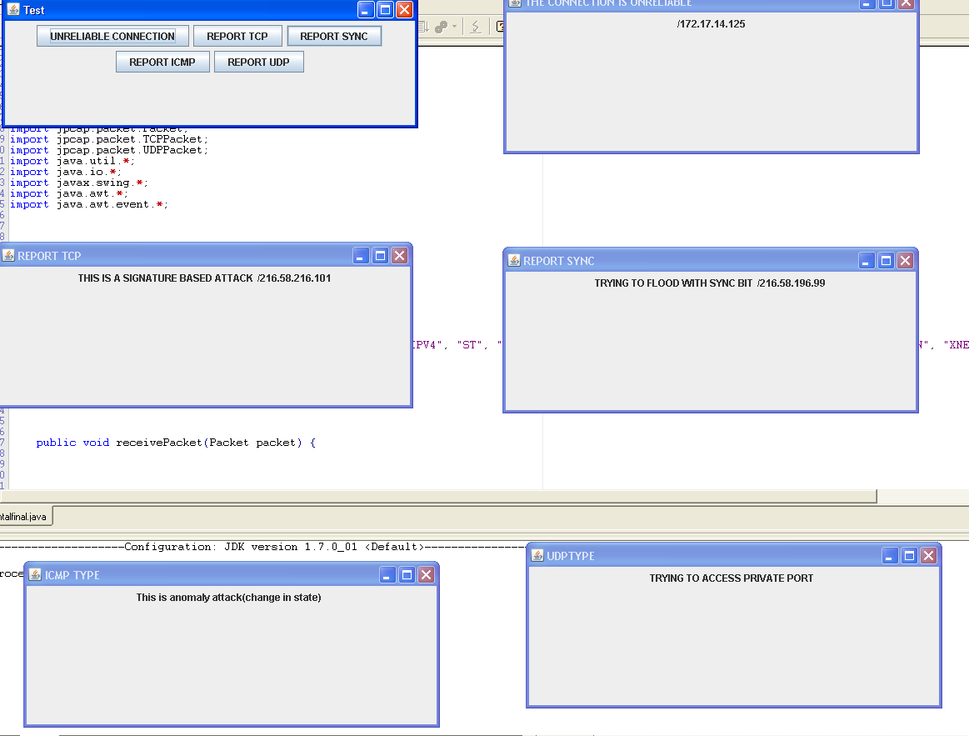

Slide 34
Limitations of IDS
Noise can severely limit an intrusion detection system's effectiveness.
It is not uncommon for the number of real attacks to be far below the number of false-alarms.
For signature-based IDSes there will be lag between a new threat discovery and its signature being applied to the IDS.
It cannot compensate for a weak identification and authentication mechanisms or for weaknesses in network protocols.
Encrypted packets are not processed by the intrusion detection software.

Slide 35
Conclusion
There are various types of attacks which can be found using the IDS.
Alarms can be set notifying the user about the attack.
Thus the IDS for various types of attacks was implemented.

Slide 36
Any Questions?

Slide 37
Thank You!

